Slide 1
Lecture 9 - The STL
(containers, iterators, and algorithms)
Programming
Principles and Practice Using C++
Shengfa Wang

Slide 2
Abstract
The STL is an extensible framework dealing with data in a C++ program.
  Succinct, Abstract & efficient
General ideal, then the fundamental concepts, and finally examples of containers and algorithms.
Templates: parameterization of a vector with an element type (templates)
The key notions of container and iterator used to tie data together with algorithms

Slide 3
Common Tasks
Collect data into containers
Organize data
  For printing
  For fast access
Retrieve data items
  By index (e.g., get the Nth element)
  By value (e.g., get the first element with the value "Chocolate")
  By properties (e.g., get the first elements where “age<64”)
Add data
Remove data
Sorting and searching
Simple numeric operations

Slide 4
Observation
We can (already) write programs that are very similar independent of the data type used
  Using an int is not that different from using a double
  Using a vector<int> is not that different from using a vector<string>

Slide 5
Ideals
We would like to write common programming tasks so that we do not have to re-do the work each time.
  Finding a value in a vector is not all that different from finding a value in a list or an array
  Uniform access to data
    Independently of how it is stored
    Independently of its type
  Fast
    Retrieval of data
    Addition of data
    Deletion of data
  Standard versions of the most common algorithms
    Copy, find, search, sort, sum, …

Slide 6
Generic Programming
Generalize algorithms
  Sometimes called “lifting an algorithm”
The aim (for the end user) is
  Increased correctness
    Through better specification
  Greater range of uses
    Possibilities for re-use
  Better performance
    Through wider use of tuned libraries
    Unnecessarily slow code will eventually be thrown away
Go from the concrete to the more abstract
  The other way most often leads to bloat

Slide 7
Lifting Example (concrete algorithms)
double sum(double array[], int n) // one concrete algorithm (doubles in array)
{
double s = 0;
for (int i = 0; i < n; ++i ) s = s + array[i];
return s;
}
struct Node { Node* next; int data; };
int sum(Node* first) // another concrete algorithm (ints in list)
{
int s = 0;
while (first) {
s += first->data;
first = first->next;
}
return s;
}

Slide 8
Lifting Example (abstract the data structure)
// pseudo-code for a more general version of both algorithms
  int sum(data) // somehow parameterize with the data structure
  {
  int s = 0; // initialize
  while (not at end) { // loop through all elements
  s = s + get value; // compute sum
  get next data element;
  }
  return s; // return result
  }
We need three operations (on the data structure):
  not at end
  get value
  get next data element

Slide 9
Lifting Example (STL version)
// Concrete STL-style code for a more general version of both algorithms
template<class Iter, class T> // Iter should be an Input_iterator
// T should be something we can + and =
T sum(Iter first, Iter last, T s) // T is the “accumulator type”
{
while (first!=last) {
s = s + *first;
++first;
}
return s;
}
Let the user initialize the accumulator
  float a[] = { 1,2,3,4,5,6,7,8 };
  double d = 0;
  d = sum(a,a+sizeof(a)/sizeof(*a),d);

Slide 10
Lifting Example
Works for
  arrays
  vectors
  lists
  istreams
  …
Runs as fast as “hand-crafted” code
  Given decent inlining
The code’s requirements on its data has become explicit
  We understand the code better

Slide 11

The STL
Designed by Alex Stepanov
General aim: The most general, most
efficient, most flexible representation
of concepts (ideas, algorithms)
  Represent separate concepts separately in code
  Combine concepts freely wherever meaningful
General aim to make programming “like math”
  or even “Good programming is math”
  works for integers, for floating-point numbers, for polynomials, for …

Slide 12
The STL
An ISO C++ standard framework of about 10 containers and about 60 algorithms connected by iterators
  Other organizations provide more containers and algorithms in the style of the STL
    Boost.org, Microsoft, SGI, …
Probably the currently best known and most widely used example of generic programming

Slide 13
Basic Model
Algorithms
  sort, find, search, copy, …
Separation of concerns
  Algorithms manipulate data, but don’t know about containers
  Containers store data, but don’t know about algorithms
  Algorithms and containers interact through iterators
    Each container has its own iterator types
iterators
Containers
  vector, list, map, hash_map, …

Slide 14
Basic Model
A pair of iterators define a sequence
  The begin (points to the first element – if any)
  The end (points to the one-beyond-the-last element)
begin:
end:
…
An iterator is a type that supports the “iterator operations”
  ++ Go to next element
  * Get value
  == Does this iterator point to the same element as that iterator?
Some iterators support more operations (e.g. --, +, and [ ])

Slide 15
Containers
vector
list
(doubly linked)
set
(a kind of tree)
0
1
2
3
0
1
2
6
2
7
0
1
5
3
4
Notes:
vector拥有一段连续的内存空间，因此支持随机存取（即使用[]操作符访问其中的元素），如果需要高效的随即存取，而不在乎插入和删除的效率，使用vector。
list拥有一段不连续的内存空间，因此不支持随机存取，如果需要大量的插入和删除，而不关心随即存取，则应使用list。

Slide 16
The Simplest Algorithm: find()
…
// Find the first element that equals a value
template<class In, class T>
In find(In first, In last, const T& val)
{
while (first!=last && *first != val) ++first;
return first;
}
void f(vector<int>& v, int x) // find an int in a vector
{
vector<int>::iterator p = find(v.begin(),v.end(),x);
if (p!=v.end()) { /* we found x */ }
// …
}
begin:
end:
We can ignore (“abstract away”) the differences between containers

Slide 17
Algorithms and Iterators
An iterator points to (refers to, denotes) an element of a sequence
The end of the sequence is “one past the last element”
  not “the last element”
  It is necessary to elegantly represent an empty sequence
  One-past-the-last-element isn’t an element
    You can compare an iterator pointing to it
    You can’t dereference it (read its value)
Returning the end of the sequence is the standard idiom for “not found” or “unsuccessful”
some iterator:
An empty sequence:
the end:
0
1
2
3

Slide 18
Simple Algorithm: find_if()
Find the first element that matches a criterion (predicate)
  Here, a predicate takes one argument and returns a bool
  template<class In, class Pred>
  In find_if(In first, In last, Pred pred)
  {
  while (first!=last && !pred(*first)) ++first;
  return first;
  }
  void f(vector<int>& v)
  {
  vector<int>::iterator p = find_if(v.begin(),v.end, Odd());
  if (p!=v.end()) { /* we found an odd number */ }
  // …
  }
A predicate

Slide 19
Functions as Algorithm Arguments
//function that prints the passed argument
void print (int elem){
cout << elem << ' ' ;
}
int main(){
vector<int> coll;
//insert elements from 1 to 9
for (int i=1; i<=9; ++i) {
coll.push_back(i);
}
  //print all elements
  for_each (coll.begin(), coll.end(), print);
  cout << endl;
}
functional

Slide 20
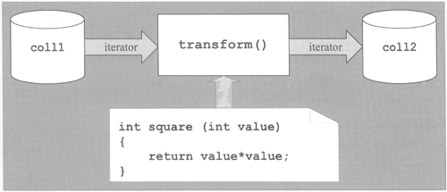
Another example
int square (int value){
return value*value;
}
int main(){
std::set<int> coll1;
  std::vector<int> coll2;
  //insert elements from 1 to 9 into coll1
  for (int i=1; i<=9; ++i) coll1.insert(i);
  PRINT_ELEMENTS(coll1,"initialized: ");
  //transform each element from coll1 to coll2
  // - square transformed values
  std::transform (coll1.begin(),coll1.end(), std::back_inserter(coll2), square);
  PRINT_ELEMENTS(coll2,"squared: ");
}

Slide 21
Predicates
A predicate (of one argument) is a function or a function object that takes an argument and returns a bool
For example
  A function
    bool odd(int i) { return i%2; } // % is the remainder (modulo) operator
    odd(7); // call odd: is 7 odd?
  A function object
    struct Odd
    {
    bool operator()(int i) const { return i%2; }
    };
    Odd odd; // make an object odd of type Odd
    odd(7); // call odd: is 7 odd?

Slide 22
Function Objects
A concrete example using state
  template<class T> struct Less_than
  {
  T val; // value to compare with
  Less_than(const T& x) :val(x) { }
  bool operator()(const T& x) const { return x < val; }
  };
  // find x<43 in vector<int> :
  p=find_if(v.begin(), v.end(), Less_than<int>(43));
  // find x<“perfection” in list<string>:
  q=find_if(ls.begin(), ls.end(), Less_than<string>("perfection"));

Slide 23
Function Objects
A very efficient technique
  inlining very easy
    and effective with current compilers
  Faster than equivalent function
    And sometimes you can not write an equivalent function
The main method of policy parameterization in the STL
Key to emulating functional programming techniques in C++

Slide 24
Some Standard Function Objects
From <functional>
  Binary
    plus, minus, multiplies, divides, modulus
    equal_to, not_equal_to, greater, less, greater_equal, less_equal, logical_and, logical_or
  Unary
    negate
    logical_not
  Others (missing, write them yourself)
    less_than, greater_than, less_than_or_equal, greater_than_or equal

Slide 25
Policy Parameterization
Whenever you have a useful algorithm, you eventually want to parameterize it by a “policy”.
  For example, we need to parameterize sort by the comparison criteria
struct Record {
string name; // standard string for ease of use
char addr[24]; // old C-style string to match database layout
// …
};
vector<Record> vr;
// …
sort(vr.begin(), vr.end(), Cmp_by_name()); // sort by name
sort(vr.begin(), vr.end(), Cmp_by_addr()); // sort by addr

Slide 26
Comparisons
// Different comparisons for Rec objects:
struct Cmp_by_name {
bool operator()(const Rec& a, const Rec& b) const
{ return a.name < b.name; } // look at the name field of Rec
};
struct Cmp_by_addr {
bool operator()(const Rec& a, const Rec& b) const
{ return 0 < strncmp(a.addr, b.addr, 24); } // correct?
};
// note how the comparison function objects are used to hide ugly
// and error-prone code
Notes:
int strncmp ( const char * str1, const char * str2, size_t n );
【参数】str1, str2 为需要比较的两个字符串，n为要比较的字符的数目。

Slide 27
vector
template<class T> class vector {
T* elements;
// …
typedef ??? iterator; // the type of an iterator is implementation defined
// and it (usefully) varies (e.g. range checked iterators)
// a vector iterator could be a pointer to an element
typedef ??? const_iterator;
iterator begin(); // points to first element
const_iterator begin() const;
iterator end(); // points one beyond the last element
const_iterator end() const;
iterator erase(iterator p); // remove element pointed to by p
iterator insert(iterator p, const T& v); // insert a new element v before p
};

Slide 28
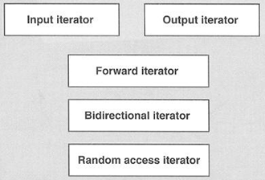


Iterator Types
vector
Every container defines two iterator types:
container::iterator
  is provided to iterate over elements in read/write mode.
2. container: : const_iterator
  is provided to iterate over elements in read-only mode.
for (pos = coll.begin(); pos != coll.end(); ++pos) {
...
}
for (pos = coll.begin() ; pos < coll.end(); ++pos) {
...
}

Slide 29
insert() into vector
vector<int>::iterator p = v.begin(); ++p; ++p; ++p;
vector<int>::iterator q = p; ++q;
q:
v:
6
p:
0
1
2
3
4
5
p=v.insert(p,99); // leaves p pointing at the inserted element
p:
q:
v:
7
0
1
2
99
3
4
5
Note: q is invalid after the insert()
Note: Some elements moved; all elements could have moved

Slide 30
erase() from vector
p:
q:
v:
7
0
1
2
99
3
4
5
p = v.erase(p); // leaves p pointing at the element after the erased one
p:
q:
v:
6
0
1
2
3
4
5
vector elements move when you insert() or erase()
Iterators into a vector are invalidated by insert() and erase()

Slide 31
list
Link:
T value
Link* pre
Link* post
template<class T> class list {
Link* elements;
// …
typedef ??? iterator; // the type of an iterator is implementation defined
// and it (usefully) varies (e.g. range checked iterators)
// a list iterator could be a pointer to a link node
typedef ??? const_iterator;
iterator begin(); // points to first element
const_iterator begin() const;
iterator end(); // points one beyond the last element
const_iterator end() const;
iterator erase(iterator p); // remove element pointed to by p
iterator insert(iterator p, const T& v); // insert a new element v before p
};

Slide 32
insert() into list
list<int>::iterator p = v.begin(); ++p; ++p; ++p;
list<int>::iterator q = p; ++q;
v:
6
p:
q:
0
1
2
3
4
5
p = v.insert(p,99); // leaves p pointing at the inserted element
p:
q:
v:
7
0
1
2
3
4
5
Note: q is unaffected
Note: No elements moved around
99

Slide 33
erase() from list
p:
q:
v:
7
0
1
2
3
4
5
99
p = v.erase(p); // leaves p pointing at the element after the erased one
p:
q:
v:
6
0
1
2
3
4
5
Note: list elements do not move when you insert() or erase()

Slide 34
Ways of traversing a vector
for(int i = 0; i<v.size(); ++i) // why int?
  … // do something with v[i]
for(vector<int>::size_type i = 0; i<v.size(); ++i) // longer but always correct
  … // do something with v[i]
for(vector<int>::iterator p = v.begin(); p!=v.end(); ++p)
… // do something with *p
know both ways (iterator and subscript)
  The iterator style is used in C (pointers only) and C++
  The iterator style is used for standard library algorithms
  The subscript style is used in essentially every language
  The subscript style doesn’t work for lists (in C++ and in most languages)
use either way for vectors
  There are no fundamental advantage of one style over the other
  But the iterator style works for all sequences
  Prefer size_type over plain int
    pedantic, but quiets compiler and prevents rare errors

Slide 35
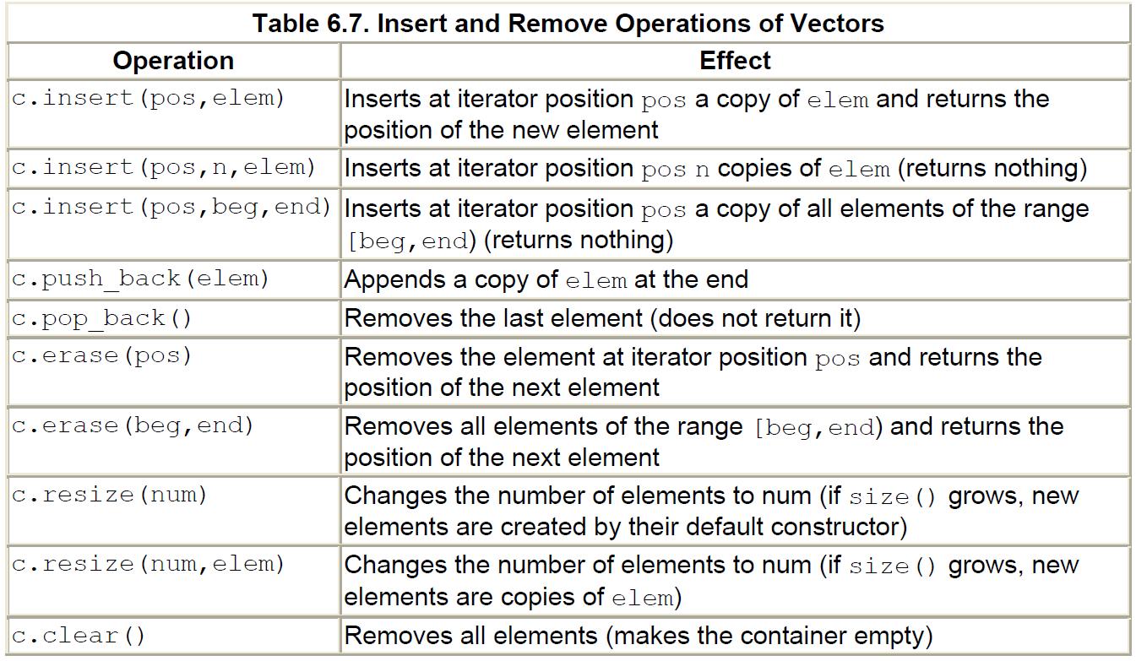

Slide 36
Some useful standard headers
<iostream> I/O streams, cout, cin, …
<fstream> file streams
<algorithm> sort, copy, …
<numeric> accumulate, inner_product, …
<functional> function objects
<string>
<vector>
<list>
<set>
<map>

Slide 37
Practice
write a Vector program using
<vector> insert, erase
<list> insert, erase
<algorithm> sort, …
<functional> function objects

Slide 38
Associative Containers
Sequence containers
  vector and list
Associative containers
  map, set
Standard algorithms
  copy, sort, …
  Input iterators and output iterators

Slide 39
Basic model
A pair of iterators defines a sequence
  The begin (points to the first element – if any)
  The end (points to the one-beyond-the-last element)
begin:
end:
…
An iterator is a type that supports the “iterator operations” of
  ++ Point to the next element
  * Get the element
  == Does this iterator point to the same element as that iterator?
Some iterators support more operations (e.g., --, +, and [ ])

Slide 40
Accumulate (sum the elements of a sequence)
template<class In, class T> T accumulate(In first, In last, T init)
{
while (first!=last) {
init = init + *first;
++first;
}
return init;
}
v:
1
2
3
4
int sum = accumulate(v.begin(),v.end(),0); // sum becomes 10

Slide 41
Accumulate (sum the elements of a sequence)
void f(vector<double>& vd, int* p, int n)
{
double sum = accumulate(vd.begin(), vd.end(), 0.0); // add the elements of vd
// note: the type of the 3rd argument, the initializer, determines the precision used
int si = accumulate(p, p+n, 0); // sum the ints in an int (danger of overflow) // p+n means (roughly) &p[n]
long sl = accumulate(p, p+n, long(0)); // sum the ints in a long
double s2 = accumulate(p, p+n, 0.0); // sum the ints in a double
// popular idiom, use the variable you want the result in as the initializer:
double ss = 0;
ss = accumulate(vd.begin(), vd.end(), ss); // do remember the assignment
}

Slide 42
Accumulate
(generalize: process the elements of a sequence)
// we don’t need to use only +, we can use any binary operation (e.g., *)
// any function that “updates the init value” can be used:
template<class In, class T, class BinOp>
T accumulate(In first, In last, T init, BinOp op)
{
while (first!=last) {
init = op(init, *first); // means “init op *first”
++first;
}
return init;
}

Slide 43
Accumulate
// often, we need multiplication rather than addition:
#include <numeric>
void f(list<double>& ld)
{
double product = accumulate(ld.begin(), ld.end(), 1.0, multiplies<double>());
// …
}
// multiplies is a standard library function object for multiplying
Note: multiplies for *
Note: initializer 1.0

Slide 44
Accumulate (what if the data is part of a record?)
struct Record {
int units; // number of units sold
double unit_price;
// …
};
// let the “update the init value” function extract data from a Record element:
double price(double v, const Record& r)
{
return v + r.unit_price * r.units;
}
void f(const vector<Record>& vr, map<string,Record*>& m) {
double total = accumulate(vr.begin(), vr.end(), 0.0, price);
// …
}

Slide 45
Inner Product
template<class In, class In2, class T>
T inner_product(In first, In last, In2 first2, T init)
// This is the way we multiply two vectors (yielding a scalar)
{
while(first!=last) {
  init = init + (*first) * (*first2); // multiply pairs of elements and sum
  ++first;
  ++first2;
}
return init;
}
number of units
*
unit price
1
2
3
4
…
*
*
*
*
4
3
2
1
…

Slide 46
Inner Product Example
// calculate the Dow Jones industrial index:
vector<double> dow_price; // share price for each company
dow_price.push_back(81.86);
dow_price.push_back(34.69);
dow_price.push_back(54.45);
// …
vector<double> dow_weight; // weight in index for each company
dow_weight.push_back(5.8549);
dow_weight.push_back (2.4808);
dow_weight.push_back(3.8940);
// …
double dj_index = inner_product( // multiply (price,weight) pairs and add
dow_price.begin(), dow_price.end(),
dow_weight.begin(),
0.0);

Slide 47
Inner Product (generalize!)
// we can supply our own operations for combining element values with“init”:
template<class In, class In2, class T, class BinOp, class BinOp2 >
T inner_product(In first, In last, In2 first2, T init, BinOp op, BinOp2 op2)
{
while(first!=last) {
init = op(init, op2(*first, *first2));
++first;
++first2;
}
return init;
}
back

Slide 48
Map (an associative array)
For a vector, you subscript using an integer
For a map, you can define the subscript to be (just about) any type
  int main()
  {
  map<string,int> words; // keep (word,frequency) pairs
  string s;
  while (cin>>s) ++words[s]; // note: words is subscripted by a string
  // words[s] returns an int&
  // the int values are initialized to 0
  typedef map<string,int>::const_iterator Iter;
  for (Iter p = words.begin(); p != words.end(); ++p)
  cout << p->first << ": " << p->second << "\n";
  }
Key type
Value type

Slide 49
Map
After vector, map is the most useful standard library container
  Maps (and/or hash tables) are the backbone of scripting languages
A map is really an ordered balanced binary tree
  By default ordered by < (less than)
  For example, map<string,int> fruits;
Key is unique
Map node:
Key first
Value second
Node* left
Node* right
…
fruits:
Orange 99
Grape 100
Quince 0
Left->first<first && first<right->first
Apple 7
Kiwi 2345
Plum 8

Slide 50
Map
Some implementation defined type
// note the similarity to vector and list
template<class Key, class Value> class map {
// …
typedef pair<Key,Value> value_type; // a map deals in (Key,Value) pairs
typedef ??? iterator; // probably a pointer to a tree node
typedef ??? const_iterator;
iterator begin(); // points to first element
iterator end(); // points to one beyond the last element
Value& operator[ ](const Key&);
iterator find(const Key& k); // is there an entry for k?
void erase(iterator p); // remove element pointed to by p
pair<iterator, bool> insert(const value_type&); // insert a new pair before p
// …
};

Slide 51
Map Example
typedef std::map<int, char *> Container;
typedef std::pair<int, char *> Element;
int main( ){
Container container; // ?
for (int nIndex = 0;nIndex < 10; nIndex ++){
char * p = new char[16];
std::cin>>p;
Element element(nIndex,p); // ?
container.insert(element); // ? }
Container::const_iterator ptr = container.find(1);
if (ptr != container.end()){
std::cout<<"find key 1 \n"; }
Container::iterator begin = container.begin();
while(begin != container.end()){
std::cout<<“element value : “<<(*begin).first <<“”<<(*begin).second \n;
delete [] (*begin).second;
(*begin).second = NULL;
begin ++; }
return 0;
}

Slide 52
Map Example (build some maps)
map<string,double> dow; // Dow Jones industrial index (symbol,price) , 03/31/2004
// http://www.djindexes.com/jsp/industrialAverages.jsp?sideMenu=true.html
dow["MMM"] = 81.86;
dow["AA"] = 34.69;
dow["MO"] = 54.45;
// …
map<string,double> dow_weight; // dow (symbol,weight)
dow_weight.insert(make_pair("MMM", 5.8549)); // just to show that a Map // really does hold pairs
dow_weight.insert(make_pair("AA",2.4808));
dow_weight.insert(make_pair("MO",3.8940)); // and to show that notation matters
// …
map<string,string> dow_name; // dow (symbol,name)
dow_name["MMM"] = "3M Co.";
dow_name["AA"] = "Alcoa Inc.";
dow_name["MO"] = "Altria Group Inc.";
// …

Slide 53
Map Example (some uses)
double alcoa_price = dow["AAA"]; // read values from a map
double boeing_price = dow["BO"];
if (dow.find("INTC") != dow.end()) // look in a map for an entry
cout << "Intel is in the Dow\n";
// iterate through a map:
typedef map<string,double>::const_iterator Dow_iterator;
for (Dow_iterator p = dow.begin(); p!=dow.end(); ++p) {
const string& symbol = p->first; // the "ticker" symbol
cout << symbol << '\t' << p->second << '\t' << dow_name[symbol] << '\n';
}

Slide 54
Map Example (calculate the DJ index)
double value_product(
const pair<string,double>& a,
const pair<string,double>& b) // extract values and multiply
{
return a.second * b.second;
}
double dj_index =
inner_product(dow.begin(), dow.end(), // all companies in index
dow_weight.begin(), // their weights
0.0, // initial value
plus<double>(), // add (as usual)
value_product // extract values and weights
); // and multiply; then sum

Slide 55
Example
Students: names and IDs
  Map?
Students: names and ages
  One to many?
  multimap

Slide 56
Set
A set is really an ordered balanced binary tree
  By default ordered by <
  For example, set<string> fruits;
Key is unique
(key_type = value_type)
set node:
Key first
Node* left
Node* right
…
fruits:
Orange
Grape
Quince
Apple
Kiwi
Plum

Slide 57
Set
#include ＜string＞
#include ＜set＞
#include ＜iostream＞
using namespace std;
int main( ) {
set ＜string＞ strset;
set ＜string＞::iterator si;
strset.insert("cantaloupes");
strset.insert("apple");
strset.insert("orange");
strset.insert("banana");
strset.insert("grapes");
strset.insert("grapes");
for (si=strset.begin(); si!=strset.end(); si++)
{ cout ＜＜ *si ＜＜ " "; }
cout ＜＜ endl;
return 0;
}
//output: apple banana cantaloupes grapes orange

Slide 58
Containers and “almost containers”
Sequence containers
  vector, list, deque
Associative containers
  map, set, multimap, multiset
“almost containers”
  array, string, stack, queue, priority_queue
Soon-to-become standard containers
  unordered_map (a hash table), unordered_set, …
For anything non-trivial, consult documentation
  Online
    SGI, RogueWave, Dinkumware
  Other books
    Stroustrup: The C++ Programming language (Chapters 16-19,22.6)
    Austern: Generic Programming and the STL
    Josuttis: The C++ Standard Library

Slide 59
Algorithms
An STL-style algorithm
  Takes one or more sequences
    Usually as pairs of iterators
  Takes one or more operations
    Usually as function objects
    Ordinary functions also work
  Usually reports “failure” by returning the end of a sequence

Slide 60
Some Useful Standard Algorithms
r=find(b,e,v) r points to the first occurrence of v in [b,e)
r=find_if(b,e,p) r points to the first element x in [b,e) so that p(x)
x=count(b,e,v) x is the number of occurrences of v in [b,e)
x=count_if(b,e,p) x is the number of elements in [b,e) so that p(x)
sort(b,e) sort [b,e) using <
sort(b,e,p) sort [b,e) using p
copy(b,e,b2) copy [b,e) to [b2,b2+(e-b))
there had better be enough space after b2
unique_copy(b,e,b2) copy [b,e) to [b2,b2+(e-b)) but
don’t copy adjacent duplicates
merge(b,e,b2,e2,r) merge two sorted sequence [b2,e2) and [b,e) into [r,r+(e-b)+(e2-b2))
r=equal_range(b,e,v) r is the subsequence of [b,e) with the value v
(basically a binary search for v)
equal(b,e,b2) does all elements of [b,e) and [b2,b2+(e-b)) compare equal?

Slide 61
Copy Example
template<class In, class Out> Out copy(In first, In last, Out res)
{
while (first!=last) *res++ = *first++;
// conventional shorthand for:
// *res = *first; ++res; ++first
return res;
}
void f(vector<double>& vd, list<int>& li)
{
if (vd.size() < li.size()) error("target container too small");
copy(li.begin(), li.end(), vd.begin()); // note: different container types
// and different element types
// (vd better have enough elements
// to hold copies of li’s elements)
sort(vd.begin(), vd.end());
// …
}

Slide 62
copy_if()
// a very useful algorithm (missing from the standard library):
template<class In, class Out, class Pred>
Out copy_if(In first, In last, Out res, Pred p)
// copy elements that fulfill the predicate
{
while (first!=last) {
if (p(*first)) *res++ = *first;
++first;
}
return res;
}

Slide 63
copy_if()
template<class T> struct Less_than {
// “typical” predicate carrying data
// this is what you can’t do simply/elegantly with a function
T val;
Less_than(const T& v) :val(v) { }
bool operator()(const T& v) const { return v < val; }
};
void f(const vector<int>& v) // “typical use” of predicate with data
// copy all elements with a value less than 6
{
vector<int> v2(v.size());
copy_if(v.begin(), v.end(), v2.begin(), Less_than<int>(6));
// …
}

Slide 64
More
Self -reading other containers
Self -reading other most used STL-style algorithms

Slide 65
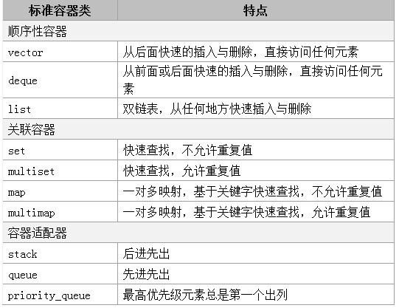
Summary

Slide 66
Summary
The common functions of all containers
constructor 提供容器默认初始化的构造函数。
copy constructor 将容器初始化为现有同类容器副本的构造函数
destructor 不再需要容器时进行内存整理的析构函数
empty 容器中没有元素时返回true,否则返回false
max_size 返回容器中最大元素个数
size 返回容器中当前元素个数
operator= 将一个容器赋给另一个容器
operator< 如果第一个容器小于第二个容器，返回true，否则返回false，
operator<= 如果第一个容器小于或等于第二个容器，返回true，否则返回false
operator> 如果第一个容器大于第二个容器，返回true，否则返回false
operator>= 如果第一个容器大于或等于第二个容器，返回true，否则返回false
operator== 如果第一个容器等于第二个容器，返回true，否则返回false
operator!= 如果第一个容器不等于第二个容器，返回true，否则返回false
swap 交换两个容器的元素
where operator>,operator>=,operator<,operator<=,operator==,operator!=均不适用于priority_queue

Slide 67
Summary
The common functions of sequence and associative containers
begin 返回iterator或const_iterator，引用容器第一个元素
end 返回iterator或const_iterator,引用容器最后一个元素后面一位
rbegin 返回reverse_iterator或const_reverse_iterator,引用容器最后一个元素
rend 返回reverse_iterator或const_reverse_iterator，引用容器第一个元素前面一位
erase 从容器中清除一个或几个元素
clear 清除容器中所有元素

Slide 68
Summary
Include the right head file (#include< >)
Choose the right containers
Use empty instead of size(0?) to judge a container
  empty is a const time, but size is linear time
  If use new operator, don’t forget to delete before destruct
  Carefully choose the right way to delete elements and update the iterators
  STL containers are not absolutely safe
  Use STL instead of your own code
  efficiency
  correctness
  maintainability

Slide 69
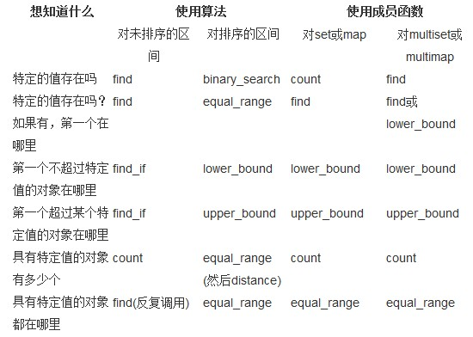
Summary (Algorithm)

Slide 70
References
The C++ Standard Library
The Use of STL and STL Extensions in CGAL
C++ Primer

Slide 71
Practice
write a Vector program using
<vector> insert, erase
<list> insert, erase
<map> insert, erase
<algorithm> sort, find …
<functional> function objects

Slide 72
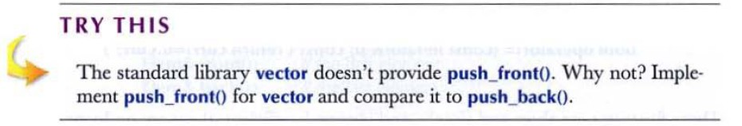
Practice

